Slide 1
LOAD CASE COMBINATION AND LOADSTEP GENERATOR FOR ALTAIR HYPERMESH
Event
Presenter
Title
Date

Slide 2
Objective
Purpose- Creating tools for automation of generation of Load combinations and Load steps (for linear analysis type).
STEP 1
Prepare unit load/pressure collectors in Hypermesh
STEP 2
Prepare CSV file with scaling factor for each load combination
STEP 3
Run the tool and prepare the TCL file for Load combination
STEP 4
Import the TCL File. Load combinations will be generated automatically
Overview for Load combination generation
Previously in Hypermesh file itself, load combination was done by combining the unit loads/pressures collectors with a scaling factor.
With load combination tool, any number of combinations can be done.

Slide 3
Overview for Load step generation
STEP 1
Prepare all load combination and SPCs in Hypermesh
STEP 2
Prepare an excel file with inputs as load step names and load/SPC IDs
STEP 3
Run the tool and prepare the TCL file for Load step generation
STEP 4
Import the TCL file and all the load steps will be generated automatically
Previously in Hypermesh file itself, for Load steps LOAD and SPCADD (for constrain) must be selected manually.
With load step tool, any number of combinations can be done.
LIMITATIONS
Constrain (SPC) combinations must be done manually after load case combinations to create a load step file. But generally, there are very few constrain combinations in a file. Thus, the manual involvement and chances of errors are very much reduced.
Load step tool is used to create linear static analysis type only. For other type of analysis, Load combination can be generated.
Bolt pretension load step cannot be generated using this tool. Hence, it has to defined manually after generating all load steps using TCL file.

Slide 4
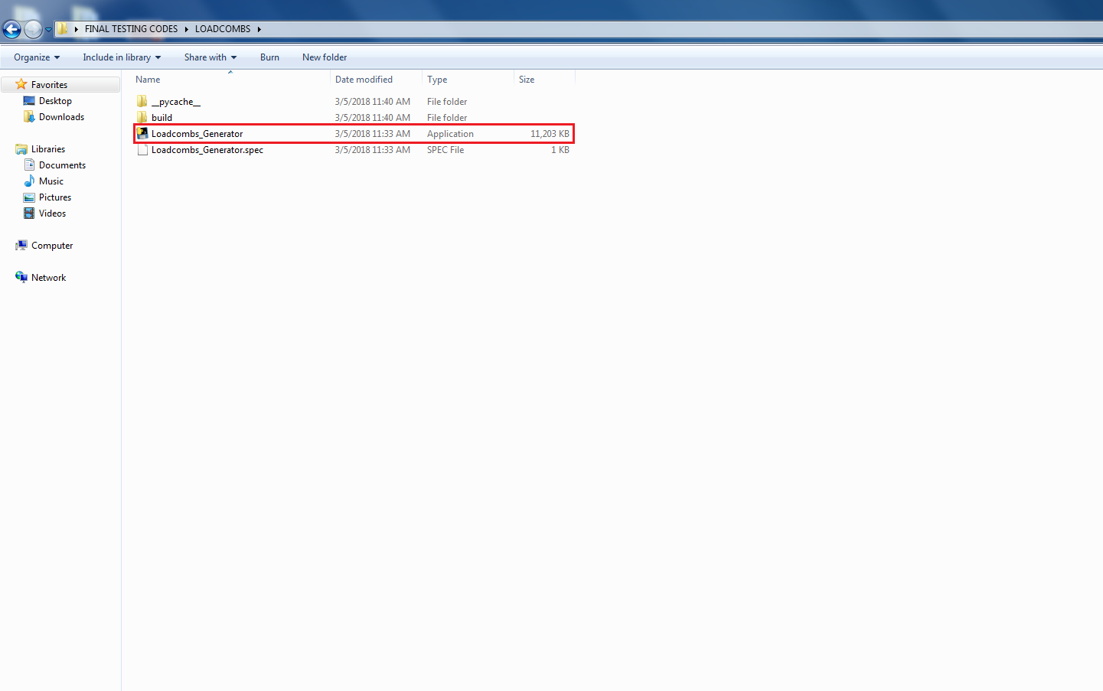
Working folder of macro tool(For load combination generation)
Do not delete any files from this folder. Run Loadcombs_Generator.exe for execution of tool while following the steps shown after this slide.

Slide 5
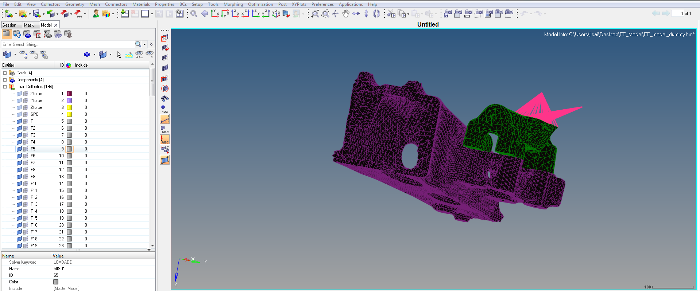
Steps to be followed for Loadcase Combination
STEP 1
Prepare the unit load collectors in the Hypermesh.

Slide 6
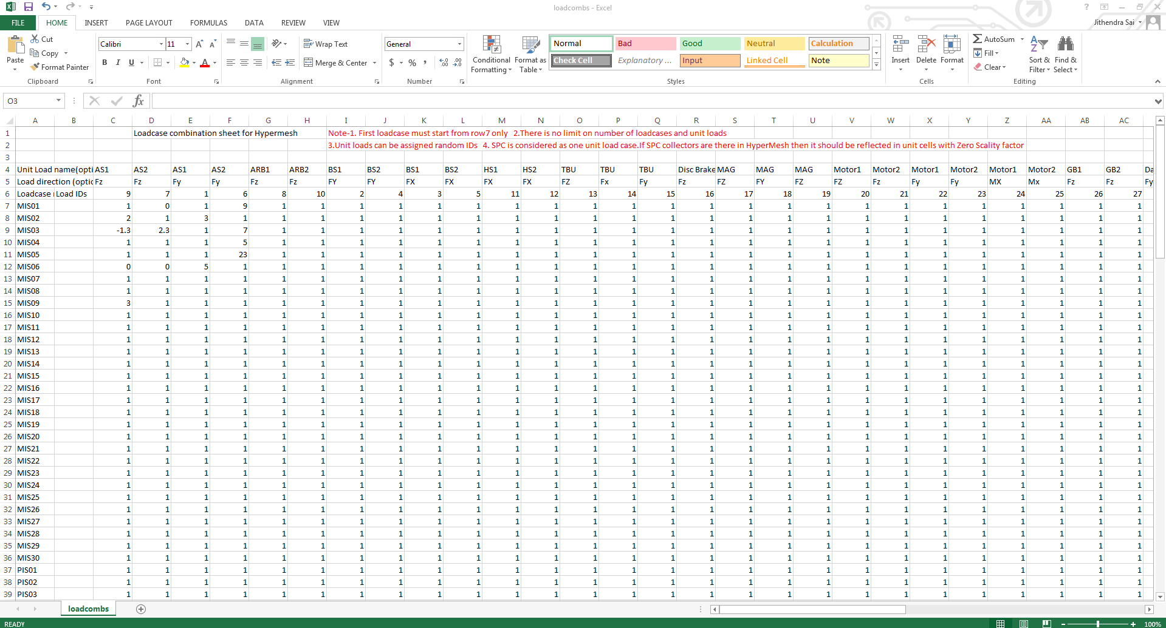
Contd.
STEP 2
Prepare the input csv file containing the load cases for a set of unit loads in the format as shown in the fig.
Read the instructions carefully.
(Note that the unit load cases IDs in CSV file should be same as the HM file)

Slide 7
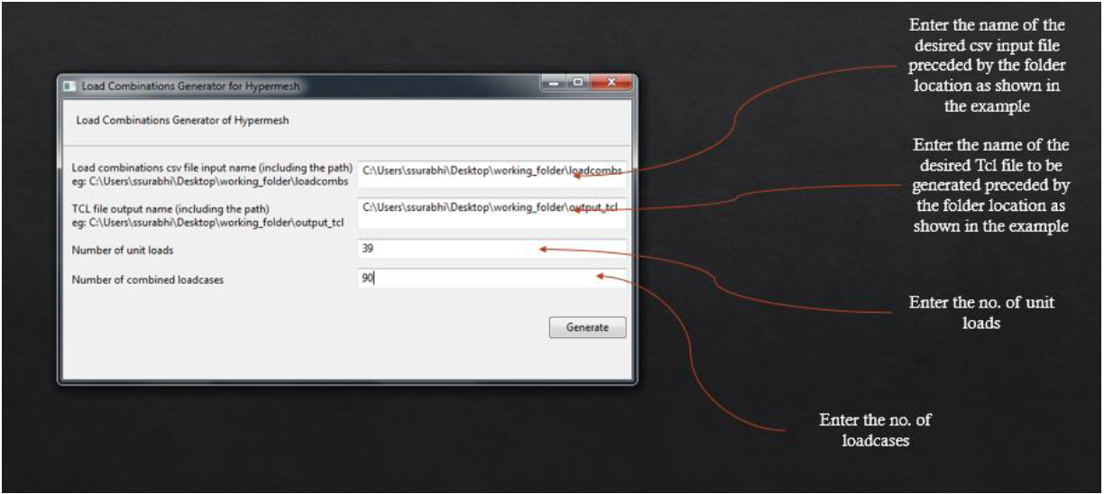
Contd.
STEP 3
Open the software and enter the following details as shown in fig.
STEP 4
Click generate to create the TCL file.

Slide 8
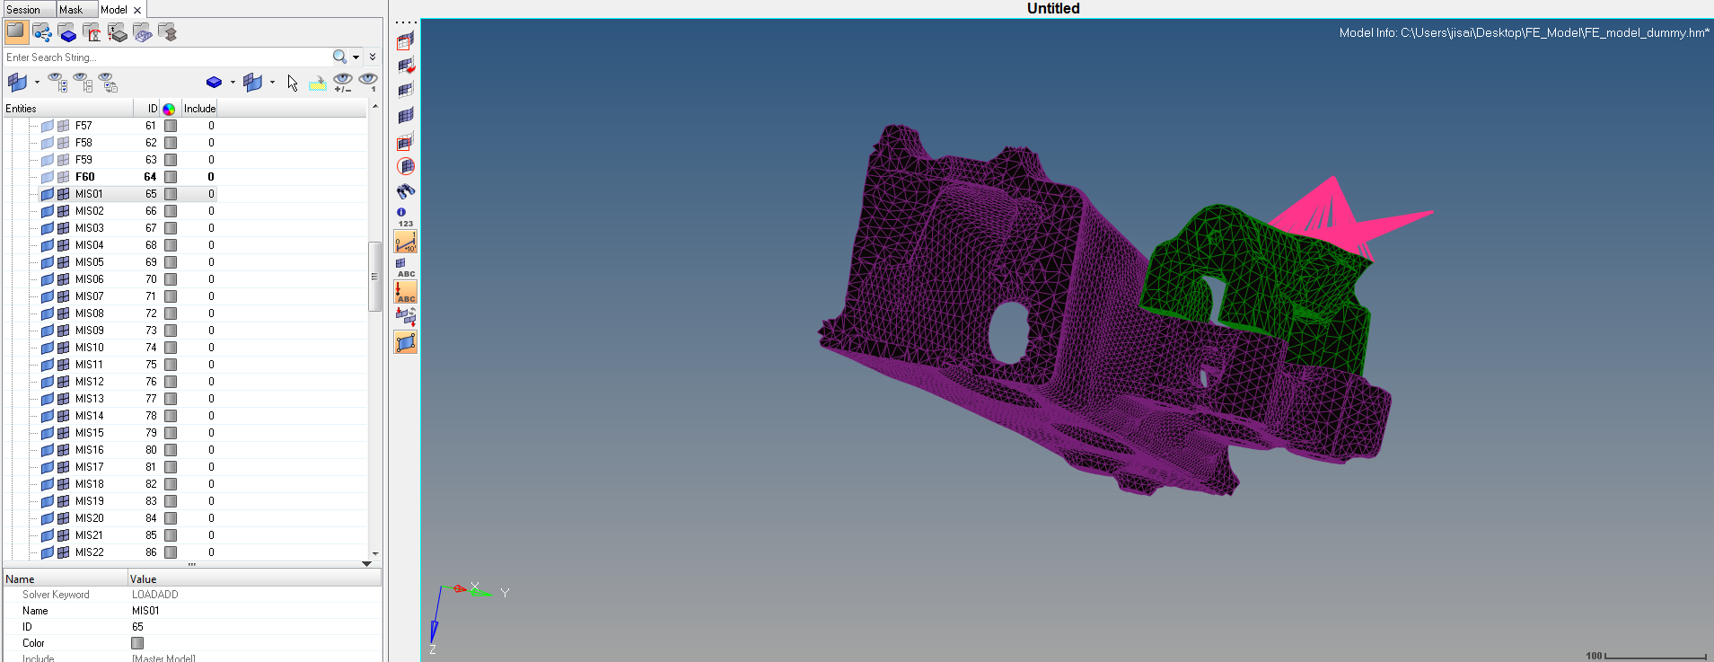
Contd.
STEP 5
Run the TCL file in Hyperworks. (File>Run>TCL script)
STEP 6
All the required load cases are generated in Hypermesh as shown in the fig.

Slide 9
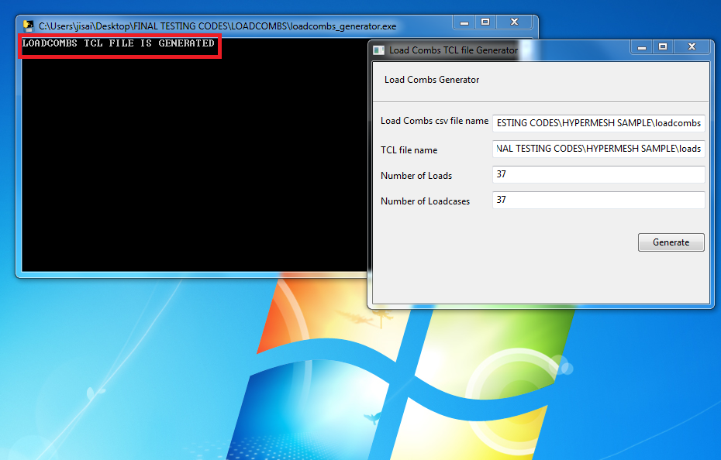
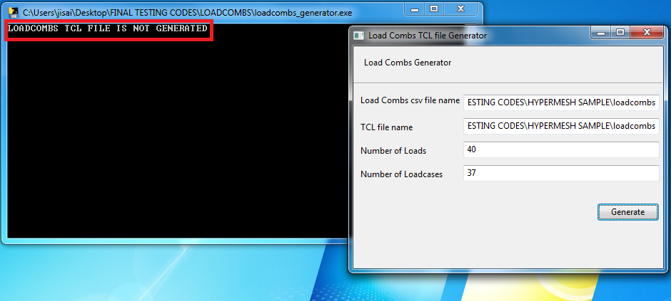
Error notification
After, clicking on generate button, “LOADCOMBS TCL FILE IS GENERATED” in the .exe window is program is successfully completed. If there is some error in input file, it will display ‘LOADCOMBS TCL FILE IS NOT GENERATED’. Both cases are displayed in figures below.

Slide 10
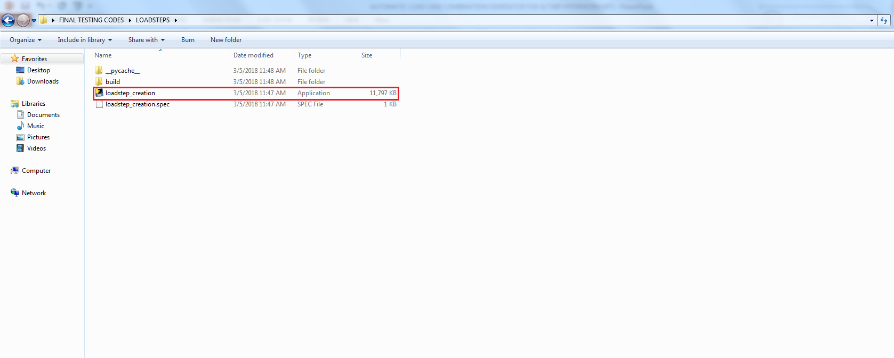
Working folder of macro tool(For load step generation)
Do not delete any files from this folder. Run loadstep_creation.exe for execution of tool while following the steps shown after this slide.

Slide 11
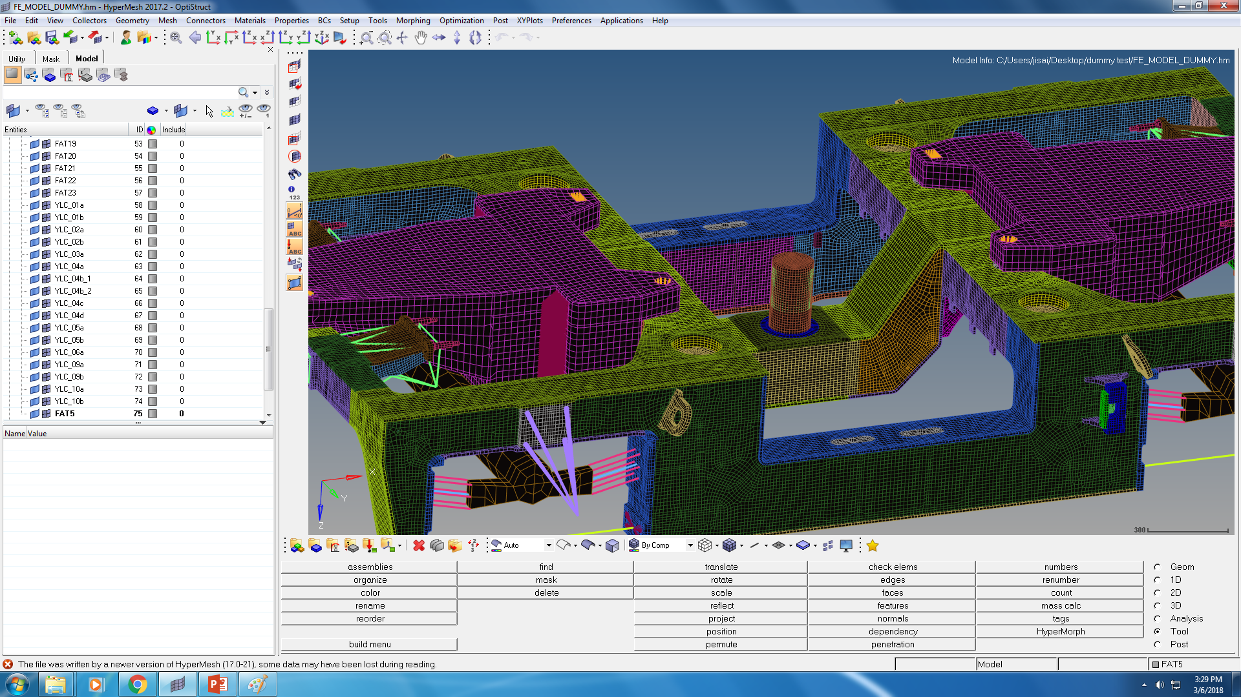
Steps to be followed for Loadstep Combination
Step 1-Create all the Load-combinations and SPC’s which are required for generating Load steps in Hypermesh.
Comment: The user has to reassign for load steps consisting only SPC(Eg.Twist cases), after completion of tool run.

Slide 12
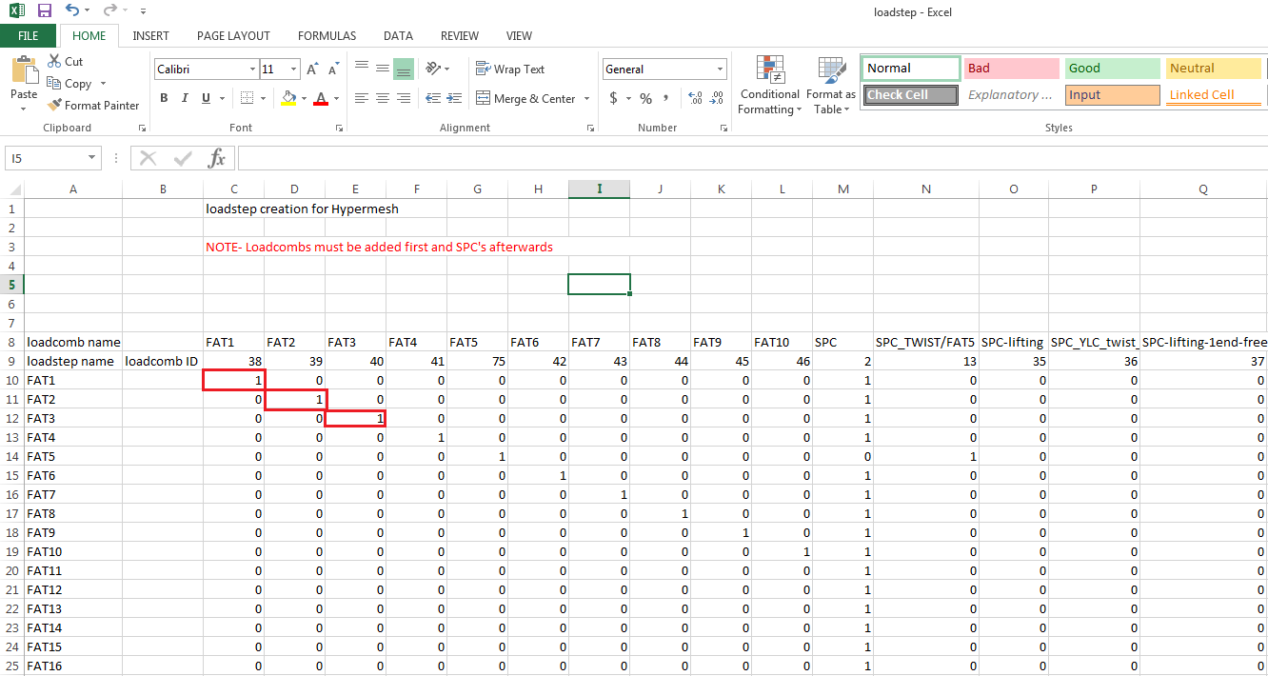
Contd.
Step 2-An excel file has to be generated as shown in the fig. Each loadstep is defined using two ‘1’, for load and SPC. Rest all cells in that column has to be zero.
1 is used for active SPC
1 is used for active load combination
First define all loadcombs
SPC’s are defined afterwards
Comment:
Load combinations and SPC IDs should be same as in Hypermesh.
In excel, First all load combinations should be mentioned and then only SPC should be added.(Always, first 1 will be assigned for LOAD card and second 1 will be assigned to SPC card of Load step card)

Slide 13
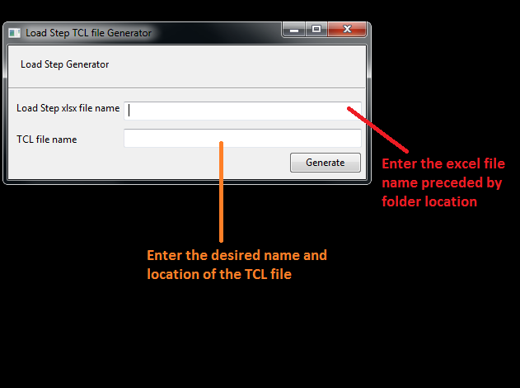
Contd.
Step 3-
Open the software and enter the following details as shown in fig.
Step 4-
Click generate to create the TCL file.

Slide 14
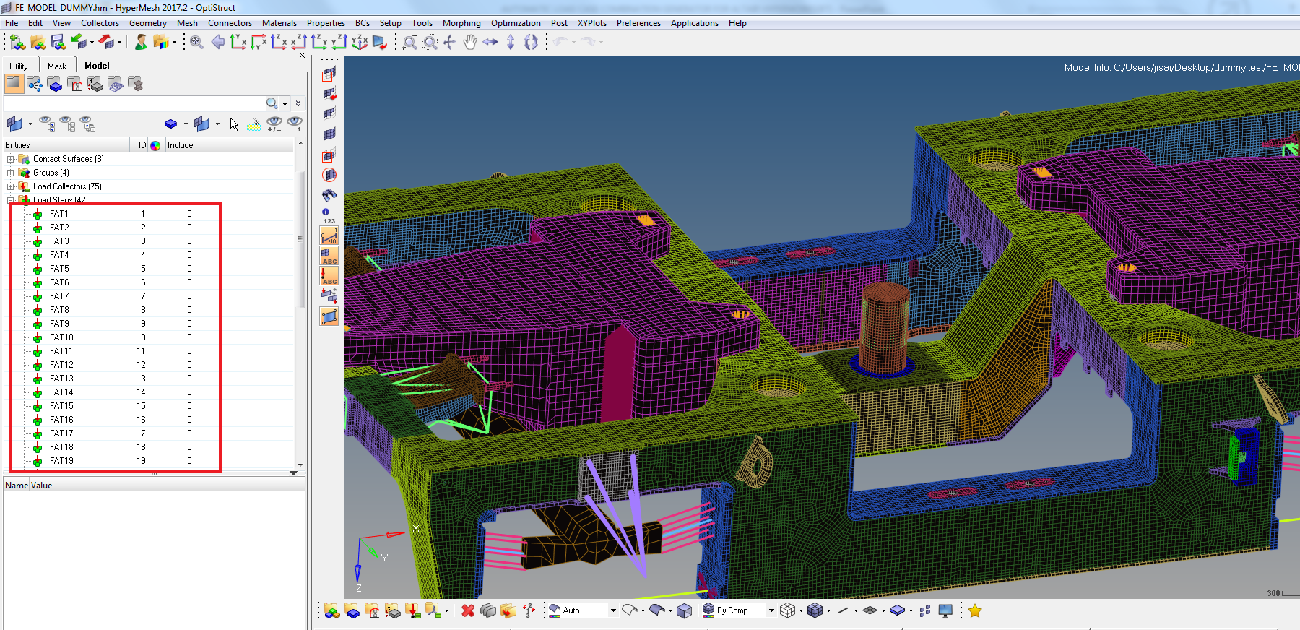
Contd.
STEP 5
Run the TCL file in Hyperworks. (File>Run>TCL script)
STEP 6
All the required load steps are generated in Hypermesh as shown in the fig.

Slide 15
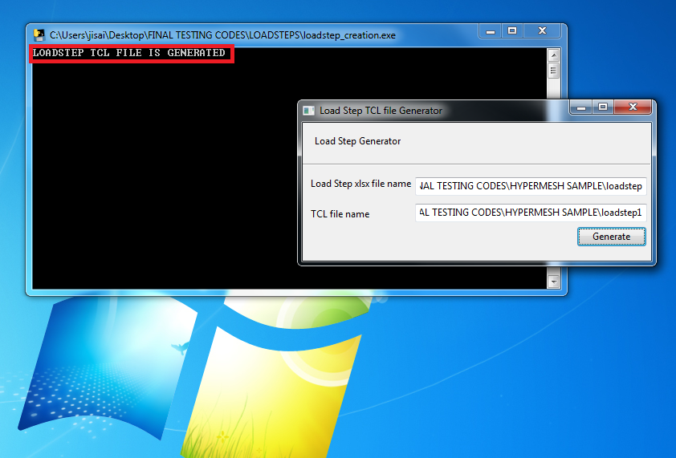
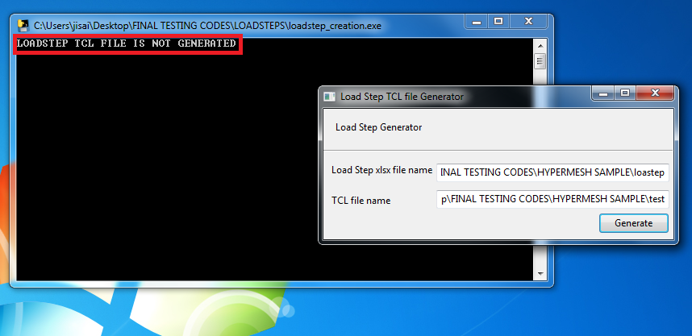
Error notification
After, clicking on generate button, “LOADSTEP TCL FILE IS GENERATED” in the .exe window is program is successfully completed. If there is some error in input file, it will display ‘LOADSTEP TCL FILE IS NOT GENERATED’. Both cases are displayed in figures below.

